Slide 1
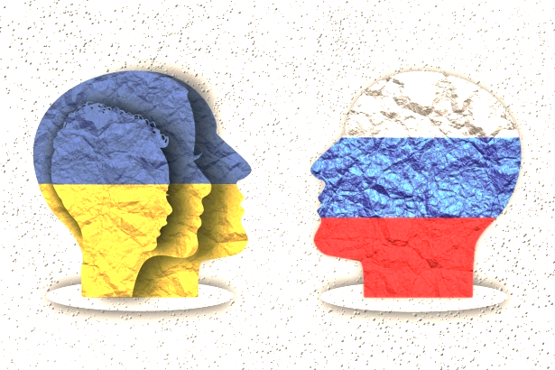
Sentiment Analysis on Russia-Ukraine War
Group 6:
Zhimeng Cao, Leon Ip, Lu Jiang, Yifan Liu, Jingyi Nie, Haizheng Sun

Slide 2
Agenda
Introduction
Problem Statement Objective
Sentiment Analysis
Findings and Results
Data visualization
Recommendations
Conclusion
Notes:
Nowadays, in our highly connected world, social media has gained more power as a platform where people can voice their opinions and ideas on a variety of subjects. Something that has grabbed our focus recently is the ongoing tension between Ukraine and Russia.

Slide 3
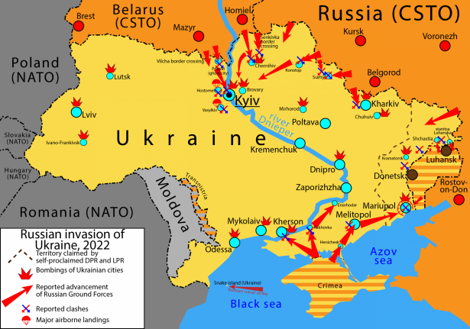
Russia-Ukraine War
Background: conflict started since 2014 and continues to this day
Objectives:
Evaluate the global perception of Ukraine and the ongoing conflict
Provide suggestions to enhance Ukraine’s international reputation and image
Notes:
The conflict between Ukraine and Russia started in 2014 and continues to this day, resulting in an essential influence on all aspects of Ukraine. Our main goal as consultants hired by the Ukrainian government is to evaluate the global perception of Ukraine and the ongoing conflict and provide 7 recommendations on how the government can enhance Ukraine’s international image and promote its interests on the global stage based on our analysis.

Slide 4

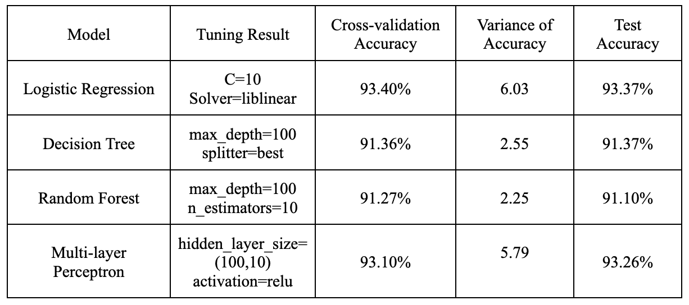


Sentiment Analysis
Trained 4 classification algorithms on the training data from classified tweets dataset
Perform best: log-regression model
Tested on posts that are collected from Twitter, Reddit, and YouTube platforms & only refer to the Russia-Ukraine war
Data visualization
Notes:
We trained 4 classification algorithms on the training data from a dataset of the classified tweets: Logistic Regression, Decision Tree, Random Forest, Multi-layer Perceptron. From the results we can tell, the logistic regression model has the highest test accuracy and cross-validation accuracy indicating a good performance of generalization. In addition, the computation time of the model is relatively low. Thus, we decided to use the logistic model, which performed best, to test on posts or comments that are collected from Twitter, Reddit and YouTube platforms and only refer to the Russia-Ukraine war. Then, we conducted some data visualization to make further analysis.

Slide 5
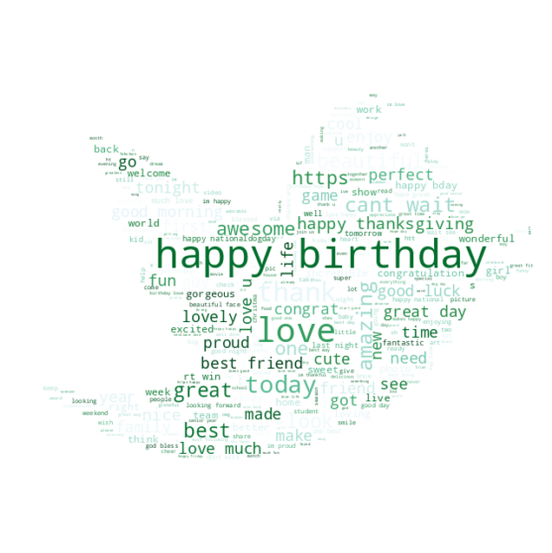
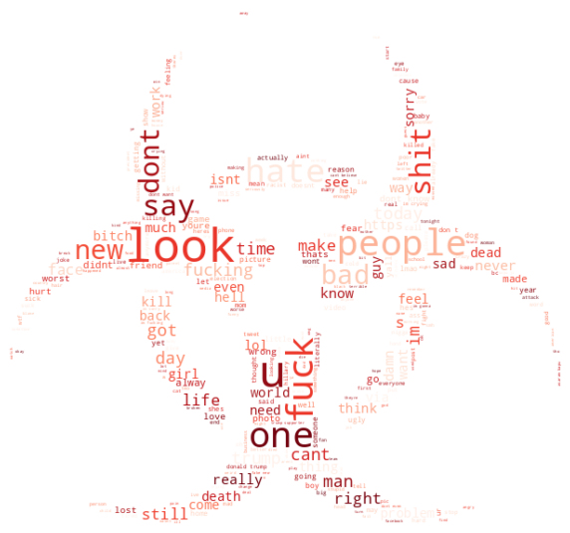
Methods of Data Visualization
Positive and negative word clouds
Histograms for the length of positive and negative posts
Line diagrams for the number of positive and negative posts
Pie charts for the percentage of positive and negative posts

Slide 6
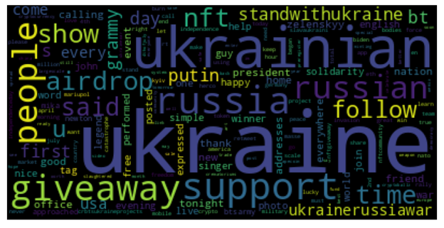
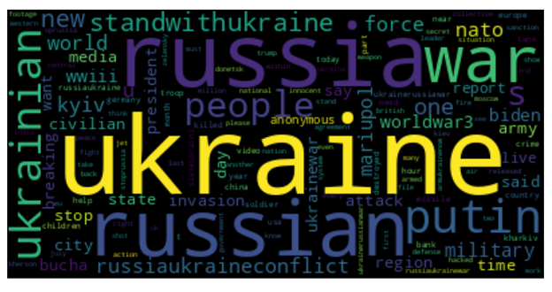
Word Clouds – Twitter
Positive Word Cloud
Negative Word Cloud
Notes:
Negative: Moving on to the word clouds, we can see the negative sentiment is conveyed through some words such as “nato”, “worldwar3”, “fighting”, “propaganda”. These terms shed light on the aspects of the conflict that the public dislikes the most. For instance, the word “propaganda” has been utilized to influence the way people think, in order to advance the interests of specific individuals or groups for political gain, and this one-sided method of spreading information has faced significant condemnation.

Slide 7
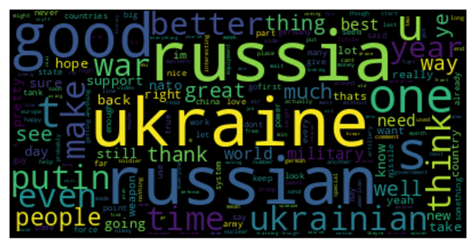
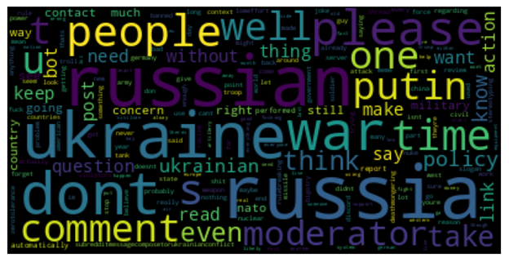
Word Clouds – Reddit
Positive Word Cloud
Negative Word Cloud
Notes:
Positive: When it comes to positive words, we can see words such as “support”, “solidarity”, “brave”, and “hope” which indicate the support from the public, as seen in the European Solidarity political party in Ukraine.

Slide 8
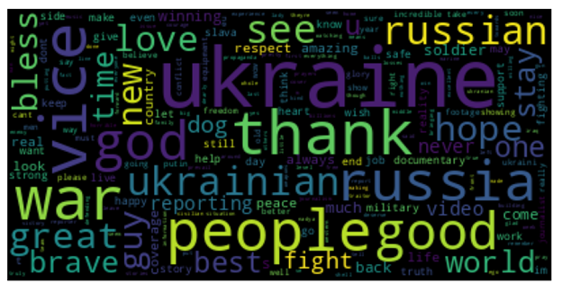
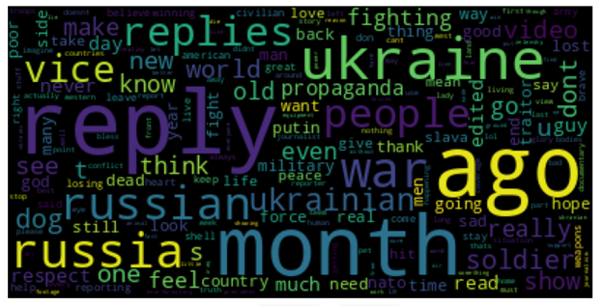
Word Clouds – YouTube
Positive Word Cloud
Negative Word Cloud

Slide 9
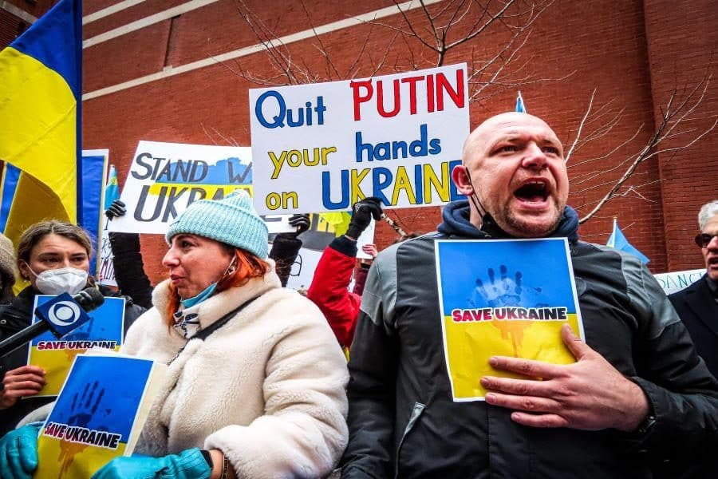
Recommendation #1
Combine keywords to create hashtags (or slogans) that give more positive or more negative sentiments:
Suggested hashtags to generate positive sentiments:
#SupportUkraine
#SoliderityWithUkraine
#BraveUkrainianSoldier
#BlessUkraine
#HopeAndPeaceUkraine
Suggested hashtags to generate negative sentiments:
#FightAgainstRussia
#WorldWar3Russia
#WW3Russia
#StopRussiaPropoganda
#StopPutin
Notes:
These hashtags can promote posts to have a higher chance of exposure. By seeing these hashtags, readers can be immersed into the expressions and ideas even before reading the posts.

Slide 10
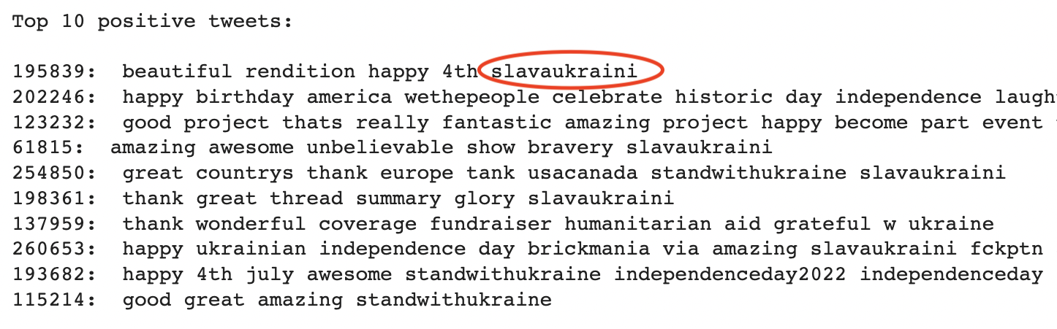
Top 10 Tweets with Positive Sentiment
#SlavaUkraini & #StandWithUkraine
Notes:
Particularly, the phrase "Slava Ukraini" was often mentioned in the top 10 positive tweets.

Slide 11
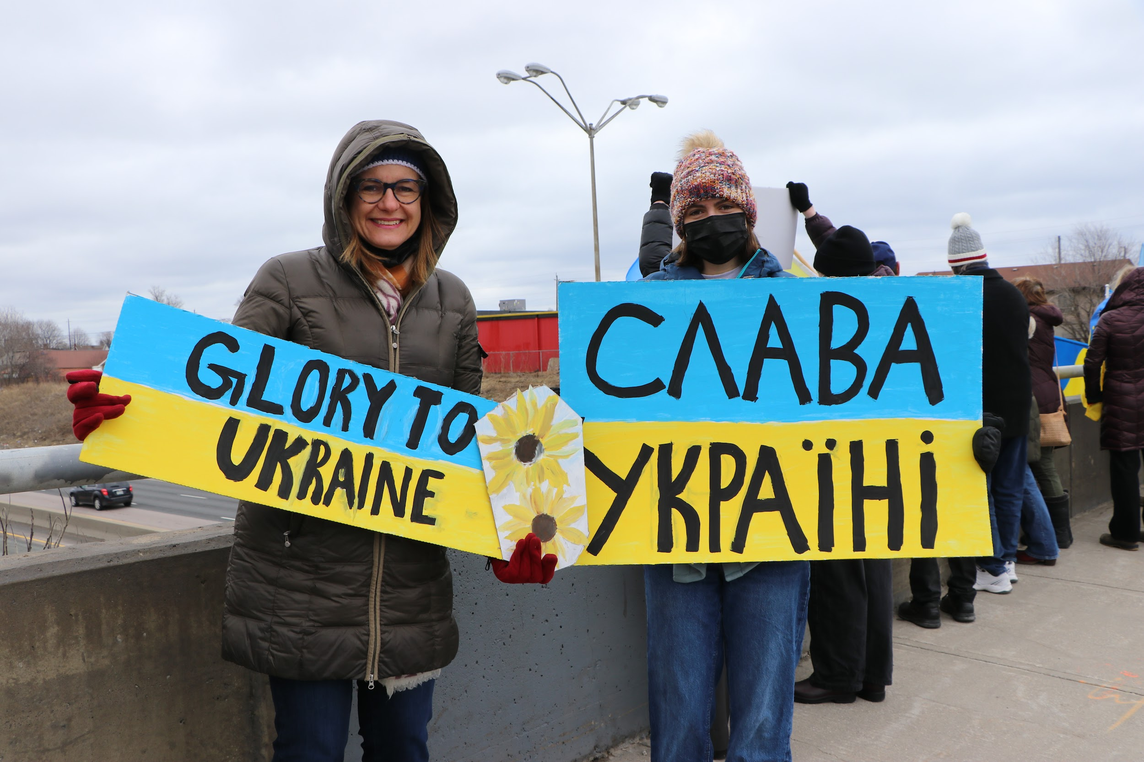
#SlavaUkraini
“Glory to Ukraine”
The independence of Ukraine
A symbol of solidarity and patriotism among Ukrainians
Expressing support for Ukraine
Alternatively, “#StandWithUkraine”
Notes:
This phrase means “Glory to Ukraine”. It is a historic slogan in Ukraine that protests to voice the independence of the country throughout Ukrainian history and is a symbol of solidarity and patriotism among Ukrainians. Currently, this phrase expresses people’s support and approval for Ukraine. Also, the phrase “StandWithUkraine” has the similar meaning.

Slide 12
Top 10 Tweets with Positive Sentiment
Notes:
Besides, the top 10 positive tweets also mention the word “independence” frequently.

Slide 13

Recommendation #2
Promote national identity and historical culture around the Independence Day of Ukraine - August 24th
Ukrainian history (e.g., independence from the Soviet Union in 1991)
Resilience of Ukrainians
Strength of Ukraine
Notes:
To effectively use the resources, it is better to prioritize the promotion about Ukraine's national identity and historical culture on social media around July and August when there is the Independence Day of the US followed by the Independence Day of Ukraine, and that will be the best time period to demonstrate and emphasize the meaning of independence for Ukraine. Acclaiming the independence from the Soviet Union in 1991, which is one of good historical moments, shows the world the resilience of Ukrainians, the strength of Ukraine, and the determination and optimism to overcome any challenge that they will face.

Slide 14
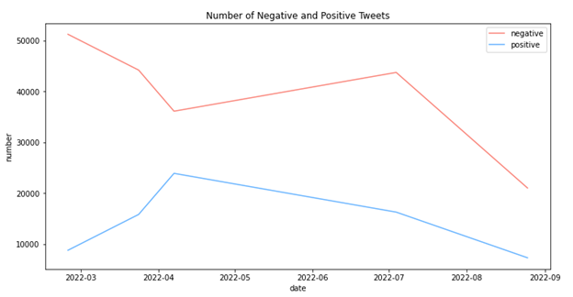
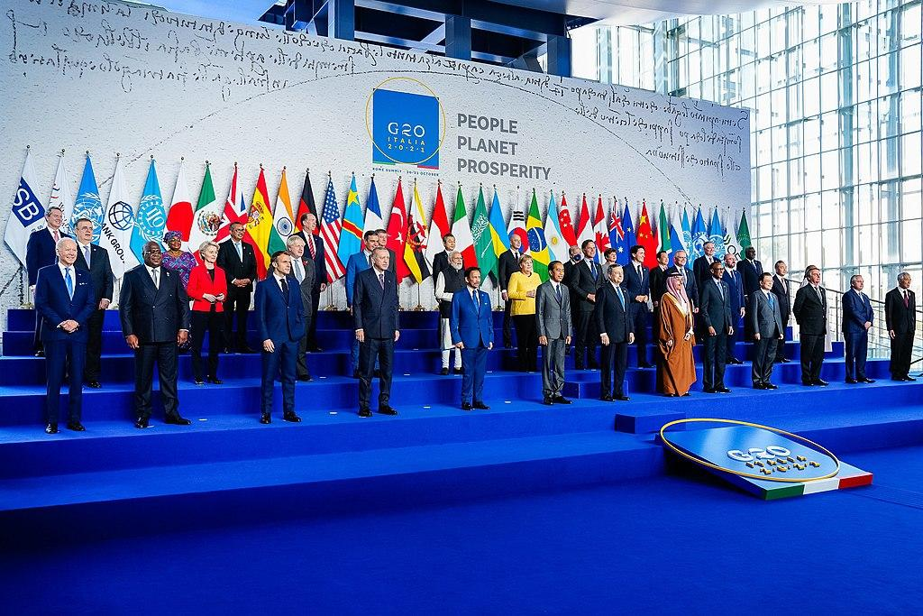
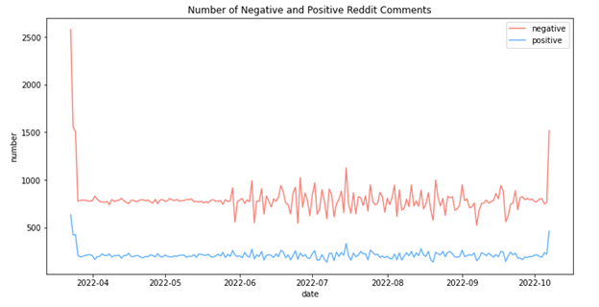
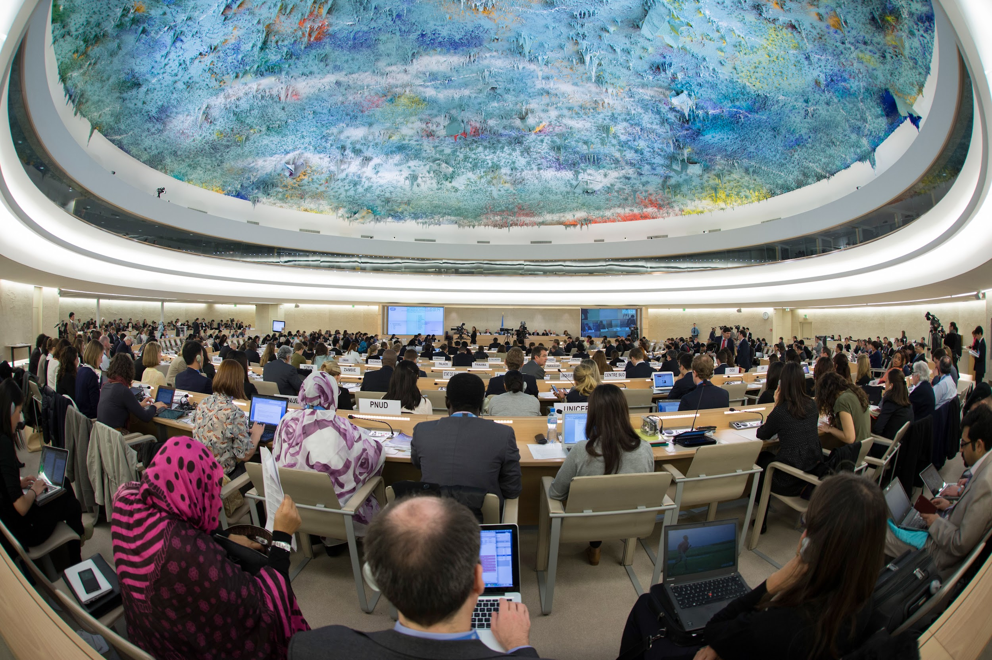
Number of Positive & Negative Posts vs. Dates
G20
Twitter
United Nations Human Rights Council
Reddit
Notes:
When looking at the timeline that illustrates the number of tweets that give positive and negative sentiments vs. dates, we have observed a significant increase in the proportion of positive sentiments and lately reaching a peak when the United States and other allied countries stand out and publicly announce their support for Ukraine, and the key events were the US prohibited US investment in Russia and called for the expulsion of Russia from the G20 and the United Nations Human Rights Council in April 2022.

Slide 15
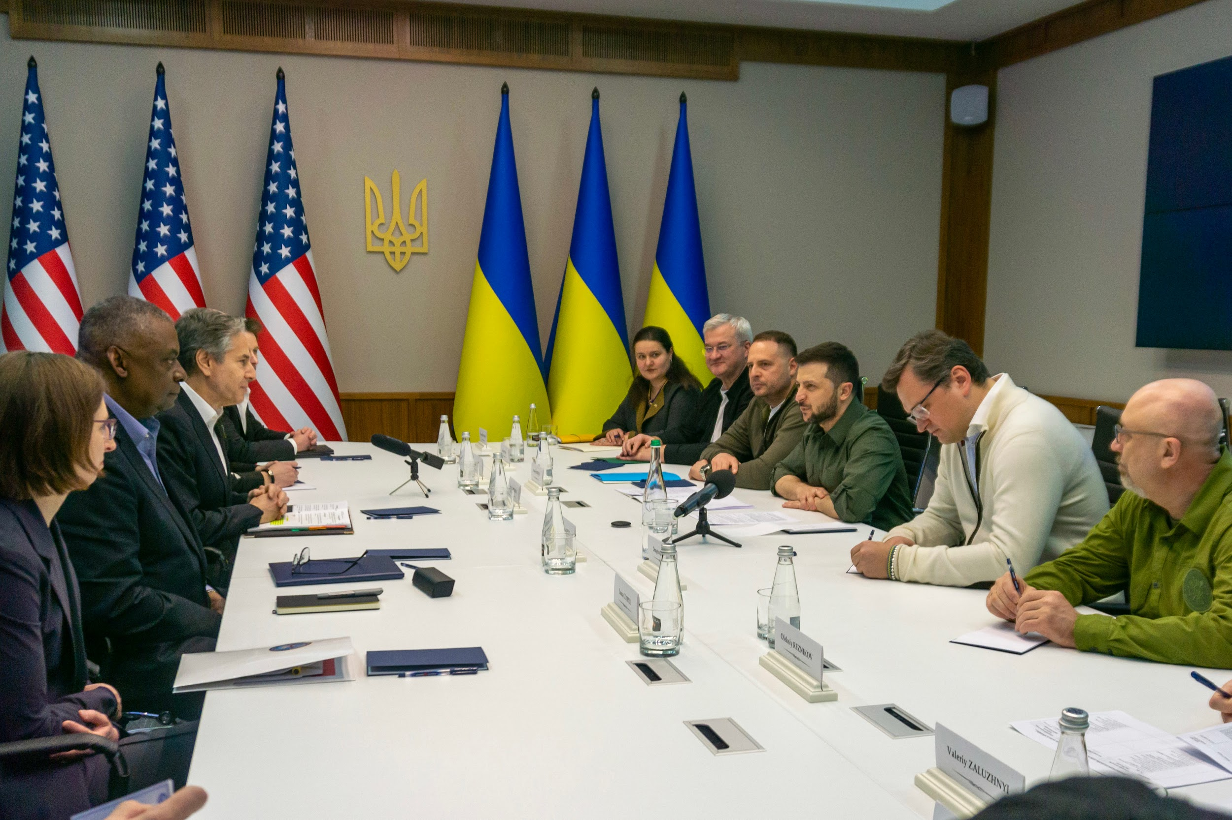
Recommendation #3
Preserve support and assistance from western countries
The US, Canada, Germany
Economic, military, and humanitarian assistance
Publicize wishes of Ukrainians and let their voice be heard by the international community
Promote international support on social media
Notes:
As what we have learned, western countries like the US, Canada, and other European countries have a significant effect on boosting positive sentiments and enhancing Ukraine’s international image. Our recommendation regarding this will be to maintain a good relationship and preserve assistance from those countries that have claimed support for Ukraine. Also, Ukrainian government can publicize the wishes of the Ukrainian people and let their voice be heard by other countries in the western world and try to gain more neutral countries’ support on social media.

Slide 16
Number of Positive & Negative Posts vs. Dates
Twitter
Reddit
Notes:
However, when we look at both Twitter and Reddit data, from a long-term perspective, people still generally have extreme hate or a high level of negative sentiment towards “war”. Ukraine, as one of the combatants in the war, cannot entirely avoid the influence of the negative sentiments that the war brings out.

Slide 17
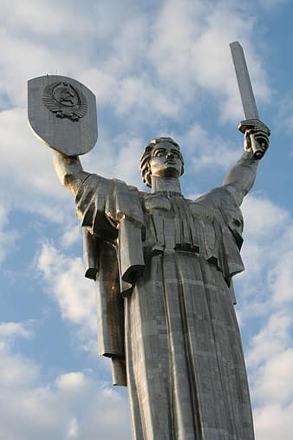
Recommendation #4
Promote Ukrainians as victims of war on social media
Gain empathy from international community
Show anti-war themes in the international community
Voice for peace
Defend the country from invaders
Establish monuments and museums to honor civilians and soldiers who sacrificed in this war
Notes:
Our recommendation for the Ukrainian government to reduce the negative sentiments of war can be to promote Ukrainians as victims of the war on social media and gain empathy from the international community. Also, Ukrainian government can show anti-war themes and try to voice for peace and declare that they are the defender of the homeland and they have not asked for the fight. Additionally, Ukrainian government can establish monuments and museums to honour civilians and soldiers who have sacrificed in the war to show their grief and repulsion caused by the war and seal them in Ukraine’s history.

Slide 18
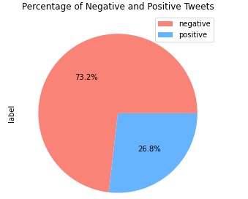
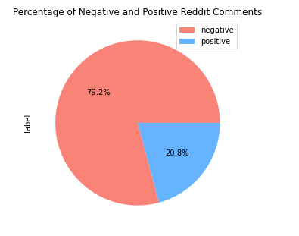
Percentage of Positive & Negative Posts
Notes:
By looking at the data in the form of pie charts, we know 70% to 80% proportion of posts and comments about the Russia-Ukraine war on Twitter, Reddit, and YouTube are considered as negative sentiments.

Slide 19
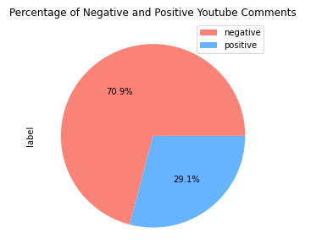
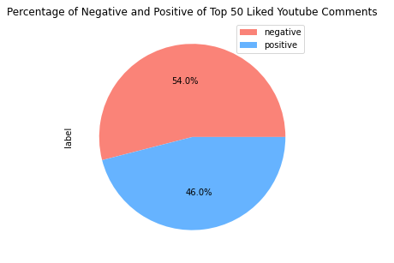
Percentage of Positive & Negative Posts
Notes:
Even for top 50 liked comments on YouTube, the negative sentiments are still found over half.

Slide 20
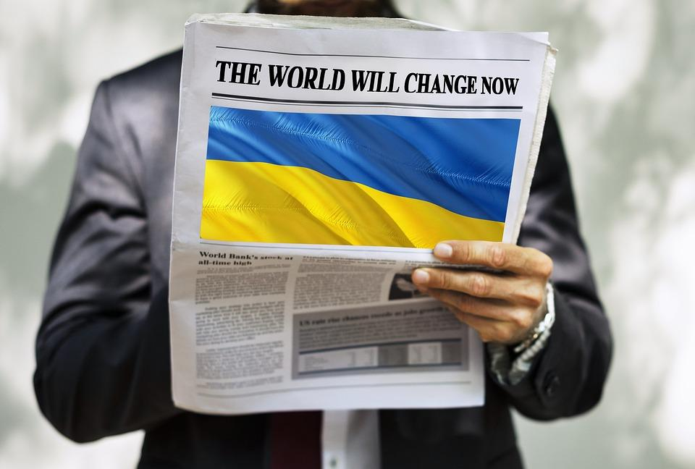
Recommendation #5
Expand positive publicity for Ukraine beyond social media to traditional media and educational institutions
Establish dedicated columns on newspapers
Broadcast documentaries on TV
Incorporate content on the Russia-Ukraine War into elementary and high schools’ history and politics curricula
Avoid the influence of negative sentiments that easily spread on social media
Promote a positive and accurate view of Ukraine's history and modern state
Notes:
Since negative sentiments are very often observed on social media, Ukrainian government can expand positive publicity beyond social media to traditional media and educational institutions, which can also cover a wider age range of audience. The implementations include establishing dedicated columns on newspapers, broadcasting documentaries to report on the latest updates on the war, and incorporating content about the Russia-Ukraine War into elementary and high schools’ history and politics curricula. The goal is to prevent people from becoming overly focused on the negative sentiments that spread on social media and to promote a more positive and accurate view of Ukraine's history and modern state.

Slide 21
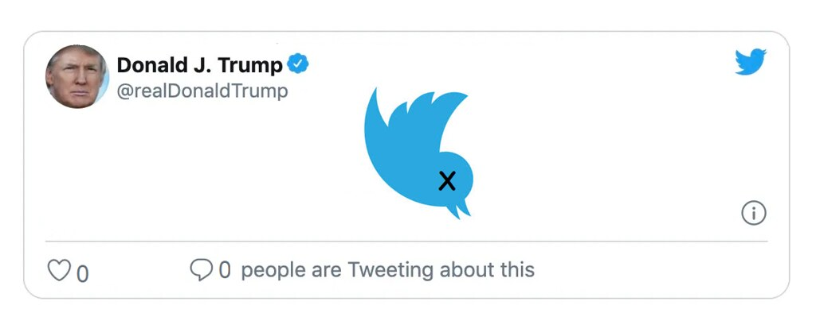
Recommendation #6
Monitor and regulate fake news that generate biases
Filter and correct misinformation
Detect and ban suspicious bot accounts on social media
Constantly express extreme comments
Notes:
Some sources of negative sentiments can be fake news and bot accounts. Therefore, our last recommendation for the Ukrainian government is to monitor and regulate fake news that can generate biases, especially for those that are not in Ukraine’s favour, and the Ukrainian government should filter and correct misinformation to minimize the damage to the country’s international reputation. Lastly, it is important for the Ukrainian government to detect and ban bot accounts which try to manipulate readers’ perspectives and sentiments and constantly leave extreme comments on social media.

Slide 22
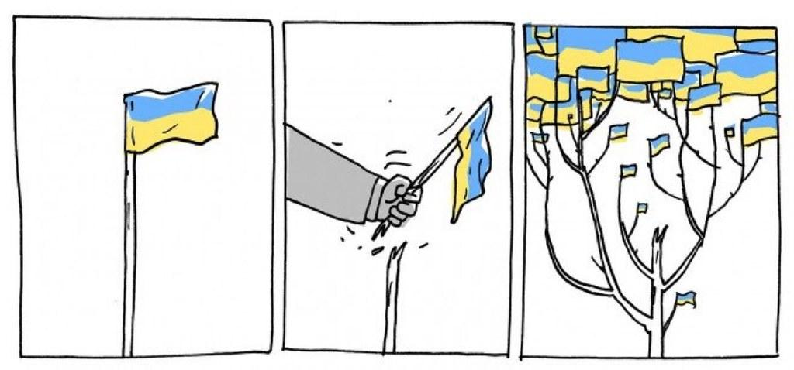
Takeaways
Create powerful hashtags
Promote national history
Secure international support
Declare peace and national defence
Refine traditional media and education
Eliminate misinformation
Notes:
In conclusion, we have delivered 6 recommendations in total after analysing reasons and factors from data visualization. Here are the takeaways that have been summarized for you to take from our presentation, which are: ……, and lastly …

Slide 23
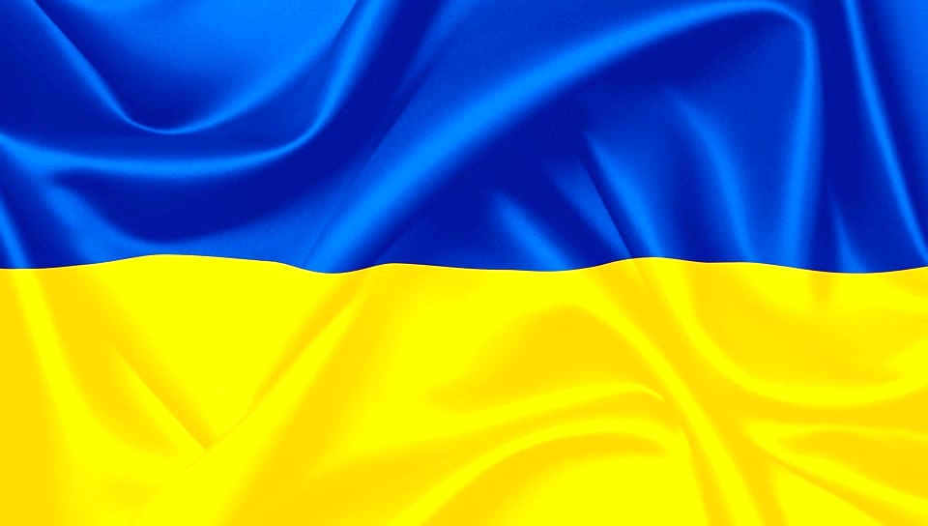
Thank you!
Дякую!
Notes:
Thank you!

Slide 24
References
Fram, T. (2023, March 13). Slava Ukraini: How to say glory to Ukraine in Ukrainian. Gwara Media. Retrieved March 31, 2023, from https://gwaramedia.com/en/slava-ukraini-how-to-say-glory-to-ukraine-in-ukrainian/#:~:text=%E2%80%9CSlava%20Ukraini%E2%80%9D%20and%20its%20meaning%20today&amp;text=Glory%20to%20heroes!%E2%80%9D%20became%20in,suppress%20the%20Ukrainian%20insurgent%20movement.
Coles, S., Ash, T., Sagoo, R., Lutsevych, O., Szostek, J., Bullough, O., Nixey, J., Benton, T., Wellesley, L., Lough, J., Froggatt, A., Lewis, P., Giles, K., Karalis, M., Jie, Y., Wolczuk, K., Shea, J., Billon-Galland, A., Vakil, S., … Rellstab, L. (2023, March 16). Seven Ways Russia's war on Ukraine has changed the world. Chatham House – International Affairs Think Tank. Retrieved March 26, 2023, from https://www.chathamhouse.org/2023/02/seven-ways-russias-war-ukraine-has-changed-world
DATA FRIENDLY SPACE (2022, April 27). UKRAINIAN CRISIS Situational Analysis (February 24th, 2023). Data Friendly Space. Retrieved March 26, 2023, from https://datafriendlyspace.org/ukraine-analyses/?gclid=Cj0KCQjw2v-gBhC1ARIsAOQdKY0lNofcNwt7lkGI_sBtJ74P4B3YkqnqIBdolhNas0v6eusRK0UU_PgaAnt7EALw_wcB
History.com Editors. (2022, December 12). Fourth of July – Independence Day. HISTORY. Retrieved April 1, 2023, from https://www.history.com/topics/holidays/july-4th
Kirby, P. (2023, February 24). Has putin's war failed and what does Russia want from Ukraine? BBC News. Retrieved March 26, 2023, from https://www.bbc.com/news/world-europe-56720589
Ministry of Foreign Affairs of Ukraine (2019, December 19). 10 facts you should know about Russian military aggression against Ukraine. Ministry of Foreign Affairs of Ukraine. Retrieved March 26, 2023, from https://mfa.gov.ua/en/10-facts-you-should-know-about-russian-military-aggression-against-ukraine
Olonade, Y. (2023, January 5). 2022 Russia-ukraine war tweets by key events. Kaggle. Retrieved March 26, 2023, from https://www.kaggle.com/datasets/yusufolonade/2022-russiaukraine-war-tweets-by-key-events
Pflughoeft, A. (2022, August 24). It’s Ukrainian Independence Day. How people in US are celebrating amid Russia assault. MiamiHerald. Retrieved April 1, 2023, from https://www.miamiherald.com/news/nation-world/national/article264790829.html
Zaliznyak, Y., &amp; Davies, G. (2022, August 24). Ukraine celebrates Independence Day as it marks 6 months of war. ABC News. Retrieved March 31, 2023, from https://abcnews.go.com/International/ukrainian-celebrates-independence-day-marks-months-war/story?id=88728029

